Slide 1
SOCIAL CONTRACT THEORIES
Key Concepts:
The State of Nature
The Social Contract
The Sovereign

Slide 2
Key Concepts:
The State of Nature: A pre-social condition.
The Social Contract: An agreement between (a) members of the community or
(b) members of the community and the Sovereign.
The Sovereign: The legitimate head of state after the Social Contract: (a) a person or group of persons, such as a monarch or a government, or (b) the people representing themselves.

Slide 3
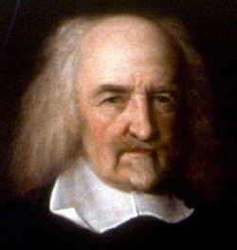
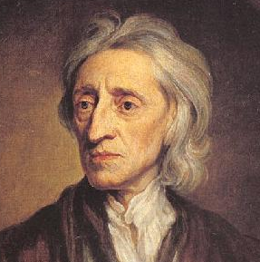
KEY PLAYERS IN SOCIAL CONTRACT THEORY
Thomas Hobbes (1588-1679): Argues in favor of absolute monarchy.
John Locke (1632-1704): Argues in favor of representational democracy. Anti-royalist.

Slide 4
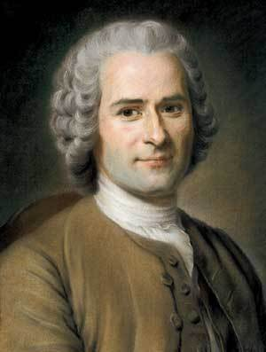
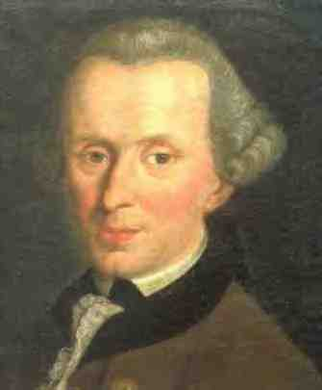
KEY PLAYERS IN SOCIAL CONTRACT THEORY
Jean-Jacques Rousseau (1712-1778): Argues in favor of direct democracy.
Immanuel Kant (1724-1804): Argues in favor of a representational system, but lead by a monarch/government with the people’s interest at heart.

Slide 5
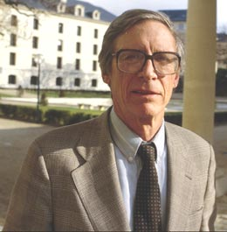
KEY PLAYERS IN SOCIAL CONTRACT THEORY
John Rawls (1921-2002): Argues in favor of an imaginary social contract within a democracy, an “Original Position.”

Slide 6
VIEWS ON HUMAN NATURE
Hobbes: Humans are selfish by nature and must be controlled.
Locke: Humans are rational by nature, and can by-and-large control themselves.
Rousseau: Humans are good and compassionate by nature, but can be corrupted by civilization.
Kant: Humans are selfish by nature, but can control themselves through rational, universalized thinking.
Rawls: Humans are selfish by nature, and the Social Contract must be made attractive by appealing to everyone’s self-interest.

Slide 7
VIEWS ON THE STATE OF NATURE:
Hobbes: The State of Nature is a dangerous place, and “life of man “ is “solitary, poor, nasty, brutish, and short.”
Locke: The State of Nature exists any time humans haven’t entered into an agreement with each other to participate in a government. Even so, it is not chaotic because of human rationality, and the three natural rights to life, liberty, and property.
Rousseau: The State of Nature is a wonderful, rich environment for early humans living solitary peaceful lives.
Kant: The State of Nature is a fiction; the Social Contract is a rational, moral concept limiting the powers of the sovereign. States are in a State of Nature vis-à-vis each other.
Rawls: The State of Nature is a fantasy, but we can use it to imagine creating a fair society.

Slide 8
THE SOVEREIGN
Hobbes: The absolute monarch (king or queen)
Locke: The people (all adult males) electing a government in democratic elections
Rousseau: The people vote on all matters; the people are the Sovereign
Kant: The monarch/government accepting the rational limitations of legislative power, governing for the people.
Rawls: Modern Republican form of government.

Slide 9
EFFECTS OF THE SOCIAL CONTRACT
Hobbes: People will live in peace but without rights except for the right to self-defense
Locke: The three natural rights which exist in the State of Nature will be easier to enforce by the government. Those who have given express consent will be bound by the contract; those who have given tacit consent can opt out and leave.
Rousseau: Life will be fair for all if we employ the general will and set aside our personal interests.
Kant: The people will be fairly represented by the Sovereign without actually having to participate.
Rawls: We will have decided on a system that is fair for everyone, using the “Veil of Ignorance.”

Slide 10


INFLUENCES
Hobbes: Inspired Locke, and indirectly, Jefferson
Locke: Inspired Thomas Jefferson in his Declaration of Independence
Rousseau: Inspired Jefferson, to some extent, but also Kant, Marxism, the environmentalist movement, respect for indigenous peoples, and modern child pedagogy
Kant: Influenced social philosophies and the human rights concept with his theory of the rights of rational human beings. Influenced John Rawls.

